Slide 1

The Enduring Legacy of African Oral Tradition
African oral tradition is a vibrant and multifaceted aspect of African culture, serving as a vital conduit for transmitting history, values, and knowledge across generations. It's a tapestry woven from stories, proverbs, myths, songs, and chants, each thread adding to the rich fabric of cultural identity and community cohesion. It's a powerful force that shapes how Africans understand their past, present, and future.
SW

Slide 2
The Enduring Legacy of African Oral Tradition," speaks to the heart of African culture and history. Imagine sitting around a fire under the vast, starry African sky, where elders share stories that have been told and retold through countless generations.
These stories, songs, and proverbs are not just entertainment; they are the lifeblood of communities, carrying the wisdom, values, and history of entire peoples.
African oral tradition is a living, breathing testament to the creativity, resilience, and spirit of its people. It is through this rich tapestry of spoken word that families stay connected to their ancestors, children learn the lessons of their heritage, and communities find unity and strength.
This introduction delves into the profound significance of these traditions, exploring how they continue to shape and enrich the lives of African people today.

Slide 3
Storytelling: The Heart of African Culture
1
Preserving Heritage
Oral tradition is the cornerstone of preserving African cultural heritage. It's how history, values, and beliefs are passed down from one generation to the next, ensuring that ancestral wisdom and traditions remain vibrant and relevant. From tales of bravery to accounts of historical events, these stories provide a connection to the past, fostering a sense of shared identity and belonging among community members.
2
Building Community
Storytelling fosters a strong sense of community. Gathering around a campfire to listen to a tale unites people, creating a shared experience that strengthens bonds and strengthens social cohesion. These stories are not just entertainment; they're a way to learn about shared values, responsibilities, and societal norms.
3
Enriching Life Experiences
African oral tradition offers a rich and diverse range of stories, encompassing folktales, myths, proverbs, and songs. These narratives provide insights into the human experience, exploring themes of love, loss, bravery, and resilience. They also serve as a source of wisdom and guidance, offering valuable lessons for navigating life's challenges.
4
Maintaining Linguistic Diversity
Oral tradition plays a crucial role in safeguarding African languages. As stories are passed down from generation to generation, they help maintain the vitality of these languages, ensuring their continued relevance and expression. Through oral storytelling, songs, and chants, African languages remain vibrant and dynamic, reflecting the rich tapestry of African cultural diversity.

Slide 4
The Importance of Indigenous Knowledge
Traditional Medicine
Sustainable Agriculture
Environmental Stewardship
Traditional healers in Africa have long relied on oral traditions to pass down knowledge about herbs, remedies, and spiritual practices used for healing. These practices, often rooted in a deep understanding of local ecosystems, have been passed down through generations, providing a valuable alternative or complementary approach to modern medicine.
Oral tradition is a vital resource for sustainable agriculture in Africa. It encompasses knowledge about soil management, crop rotation, water conservation, and ecological balance, passed down through stories, songs, and practical demonstrations. These traditional practices have allowed communities to thrive in harmony with the environment for centuries.
African oral traditions often emphasize the importance of respecting nature and living in harmony with the environment. Stories about ancestral spirits, sacred places, and the interconnectedness of all living things promote a sense of responsibility for the well-being of the natural world. This knowledge is crucial for safeguarding biodiversity and ensuring the sustainability of ecosystems.

Slide 5
Environmental conservation.
Indigenous knowledge holds immense importance as it encompasses the wisdom, traditions, and skills that have been developed and passed down through generations within native communities. Firstly, it plays a crucial role in environmental conservation.
Indigenous peoples have an intimate understanding of their local ecosystems, utilizing sustainable practices that have preserved biodiversity for centuries.
Their knowledge of plant species, animal behavior, and weather patterns is invaluable in efforts to combat climate change and promote ecological balance.

Slide 6
Indigenous knowledge is essential for cultural identity and community cohesion.
It encompasses languages, rituals, art, and social practices that define and preserve the unique cultural heritage of indigenous peoples.
By maintaining and celebrating their traditions, these communities foster a strong sense of belonging and continuity, which is vital for their social and emotional well-being.
Indigenous knowledge contributes to global innovation and problem-solving.
Traditional medicine, agricultural techniques, and resource management strategies offer alternative approaches that can complement modern science and technology. Integrating indigenous knowledge with contemporary practices can lead to more holistic and effective solutions to global challenges, ranging from healthcare to sustainable development. Embracing and respecting this knowledge not only honors the contributions of indigenous peoples but also enriches our collective understanding and ability to address complex issues.

Slide 7
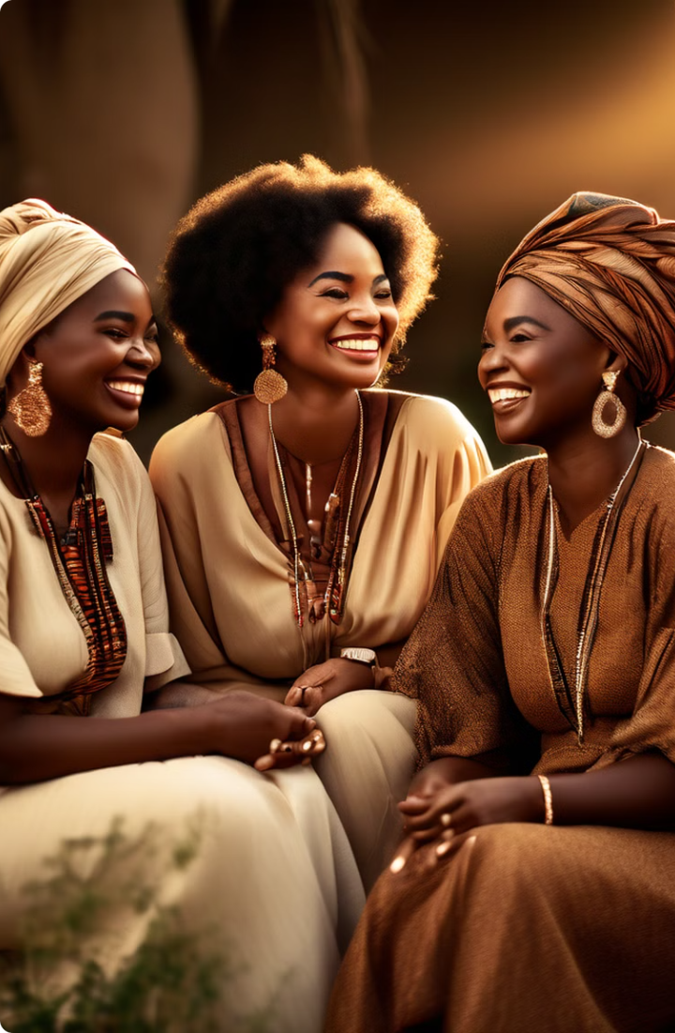
Addressing Historical Biases in Storytelling
1
Traditional Gender Roles
Historically, many traditional stories and proverbs have reinforced gender stereotypes and patriarchal norms. Women were often depicted in subordinate roles, reflecting the societal expectations of the time. These narratives sometimes reinforced traditional gender roles, limiting opportunities for women and perpetuating social inequalities.
2
The Rise of Female Storytellers
In recent years, there's been a growing movement to challenge these biases and promote gender equality. Female storytellers, griots, poets, and performers are increasingly gaining recognition and platforms to share their voices and experiences. This shift is not just about inclusion; it's about honoring the diverse perspectives and contributions of women in society.
3
Reframing Narratives
This movement is reimagining traditional stories, highlighting the strength, resilience, and leadership of women. It's about reclaiming narratives and ensuring that women's voices are heard and celebrated. This process is crucial for creating a more balanced and equitable representation of women in African oral traditions.

Slide 8
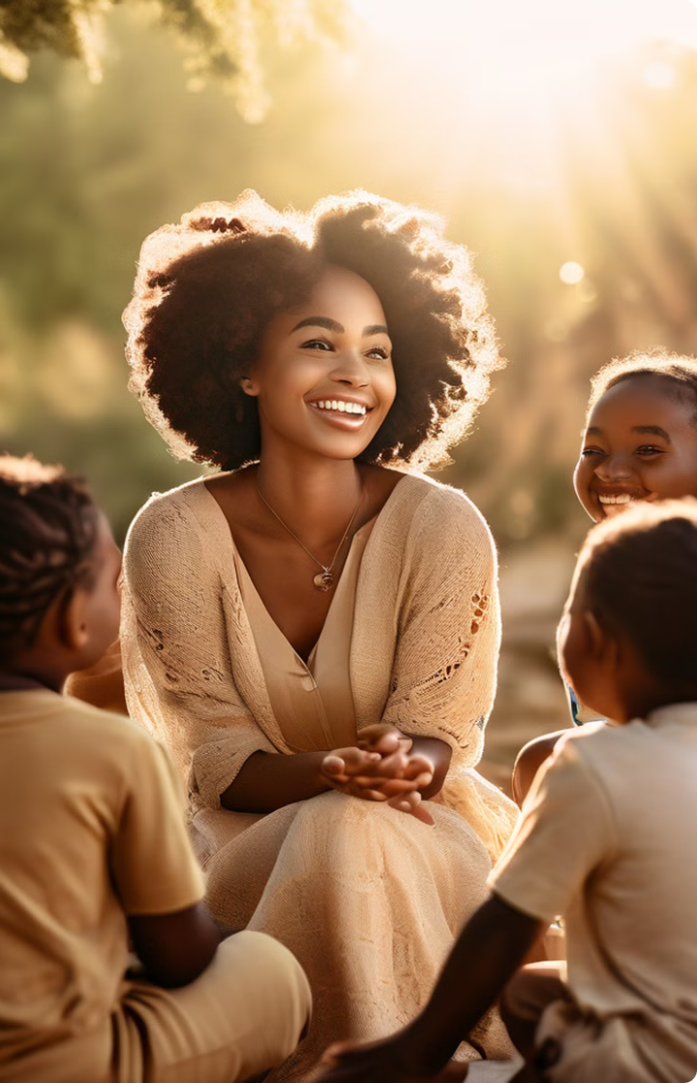
Modern Issues in African Storytelling
Gender Equality
Contemporary storytellers are increasingly incorporating themes of gender equality into their narratives. Stories are being told that challenge traditional biases and promote a more equitable society, where women and girls have equal opportunities to thrive.
Environmental Sustainability
Environmental issues are becoming increasingly relevant in African storytelling. Stories about climate change, pollution, and the importance of conservation are being woven into traditional narratives, raising awareness about these critical challenges.
Social Justice
Storytellers are using their platform to address social justice issues, highlighting inequalities, systemic racism, and the need for social change. These narratives inspire action and encourage communities to work towards a more just and equitable future.
Technological Advancement
The impact of technology on African societies is also being explored in modern storytelling. Stories are being told that examine the role of the internet, social media, and digital technologies in shaping African cultures and communities.

Slide 9
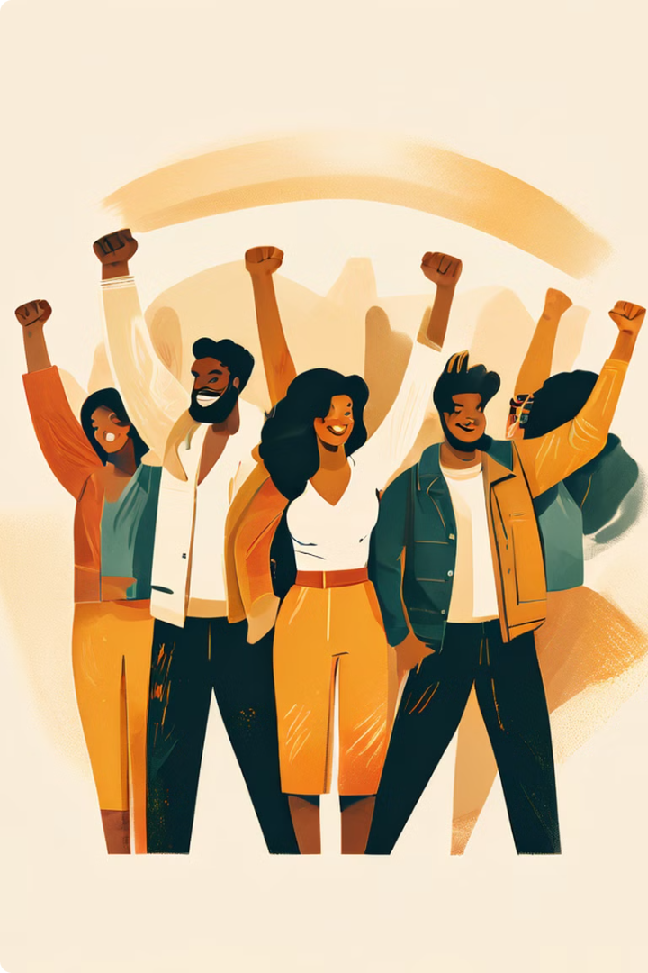



Oral Tradition as a Tool for Social Change
Amplifying Diverse Voices
By giving voice to a wider range of perspectives, African oral tradition is becoming a powerful tool for social change. It's about celebrating diversity, honoring different experiences, and ensuring that everyone has a platform to be heard.
Promoting Inclusivity
Inclusive storytelling is crucial for building a more equitable and just society. By incorporating diverse perspectives, challenging traditional biases, and promoting understanding, African oral traditions are creating a more inclusive and welcoming space for all.
Driving Positive Change
Through storytelling, communities are coming together to address social issues, advocate for change, and build a better future. Oral tradition provides a platform for sharing ideas, raising awareness, and inspiring action, leading to tangible improvements in society.

Slide 10
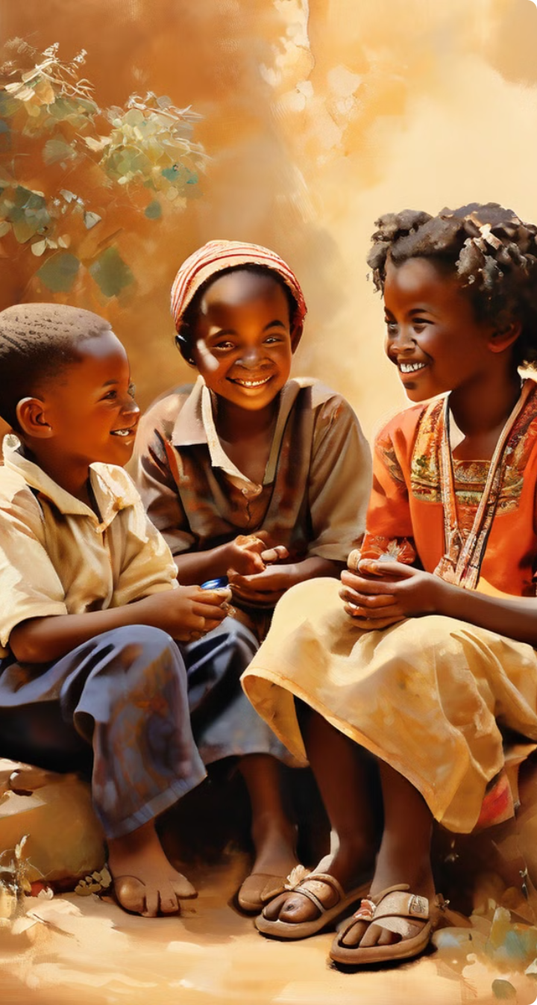




The Future of African Oral Tradition
Preservation and Documentation
The rapid pace of change and the impact of globalization require renewed efforts to preserve and document African oral traditions. This includes initiatives to record stories, songs, and chants, ensuring their survival for future generations.
Integration with Education
Integrating oral traditions into educational curricula is essential for connecting young people to their cultural heritage. This can foster a deeper understanding of African history, values, and perspectives, ensuring that these traditions are passed down to future generations.
Global Reach
African oral tradition is not just a local phenomenon; it has the potential to engage global audiences. Sharing these stories through translation, performance, and digital platforms can foster intercultural understanding and appreciation for African cultures.
Adaptability and Evolution
African oral tradition is a dynamic and evolving force. It will continue to adapt to changing times, incorporating new ideas, technologies, and perspectives, ensuring its continued relevance and vitality.

Slide 11
The Power of Storytelling
African oral tradition serves as a powerful reminder of the enduring power of storytelling. It connects us to our past, shapes our present, and inspires our future. It's a testament to the human spirit's ability to share experiences, knowledge, and wisdom through the art of narrative. These stories are not just words; they are vessels of cultural memory, social cohesion, and hope for a better future.

Slide 12

The Enduring Legacy
African oral tradition is a vibrant tapestry woven from stories, songs, and wisdom passed down through generations. It's a testament to the enduring legacy of African culture, reminding us of the importance of preserving heritage, fostering community, and embracing the power of storytelling. It's a living tradition that continues to inspire, unite, and drive positive change in African societies today.

Slide 13
CONCLUSION
In conclusion, indigenous knowledge is a treasure trove of wisdom that offers invaluable insights into environmental conservation, cultural identity, and global innovation. By respecting and integrating these time-honored practices and perspectives, we can develop more sustainable and holistic approaches to address the pressing challenges of our time.
Preserving indigenous knowledge is not only about honoring the heritage of native communities but also about recognizing its vital role in creating a more balanced, diverse, and resilient world for future generations.
Embracing this knowledge allows us to build bridges between the past and the future, fostering a deeper understanding and appreciation of the rich tapestry of human experience.

